Slide 1
Capstone Project (DA):-
Credit Card Fraud Detection
Submitted By:- (DSC 43)
Prashant Singh
Vaibhav Singh
Shreya Mandlesha

Slide 2
Agenda
Objective /Problem Statement
Background
Problem-solving approach
Key Insights /Visualization
Cost Benefit Analysis
Appendix:-
Data Attributes
Data Methodology
Attached Files

Slide 3
Objective / Problem Statement
As a part of the analytics team working on a fraud detection model and its cost-benefit analysis. We need to develop a machine learning model to detect fraudulent transactions based on the historical transactional data of customers with a pool of merchants.
We have to analyze the business impact of these fraudulent transactions and recommend the optimal ways that the bank can adopt to mitigate the fraud risks.
We need to put proactive monitoring and fraud prevention mechanisms in place.
Machine learning helps these institutions reduce time-consuming manual reviews, costly chargebacks and fees, and denial of legitimate transactions.

Slide 4
Background
The number of fraudulent transactions has increased drastically, due to which credit card companies are facing a lot of challenges. For many banks, retaining highly profitable customers is the most important business goal. Banking fraud, however, poses a significant threat to this goal.
In terms of substantial financial loss, trust and credibility, banking fraud is a concerning issue for both banks and customers alike.
With the rise in digital payment channels, the number of fraudulent transactions is also increasing as fraudsters are finding new and different ways to commit such crimes.
We have performed the root cause analysis for the increasing number of frauds and high revenue loss, and you realized that building a fraud detection system using different machine learning techniques is quite important to identify such fraudulent activities at the right time and prevent them from happening.

Slide 5
Problem-solving approach
Reading and Understanding the Data
Data Inspection/ Cleaning / Transformation
EDA (Univariate and Bivariate analysis)
Data Preparation (Train/Test Data Splitting)
Multiple Model Building or Hyperparameter Tuning
Model Evaluation
Business Impact: - Cost Benefit Analysis (Before and After Model deployment)

Slide 6
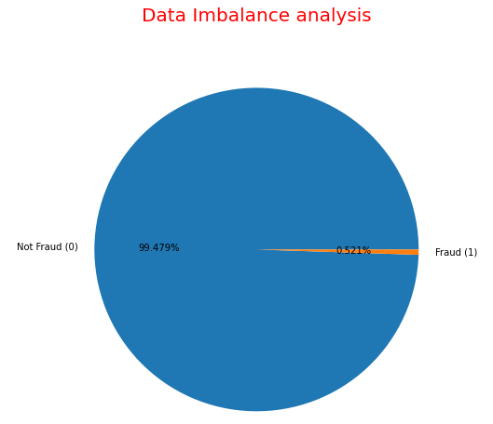
Key Insights /Visualization
Data set is highly imbalanced, Out of a total of 18,52,394 transactions, 9651 are fraudulent, with the positive class (frauds) accounting for 0.521% of the total transactions. Class Not fraud accounting for 99.479% of total transactions.

Slide 7
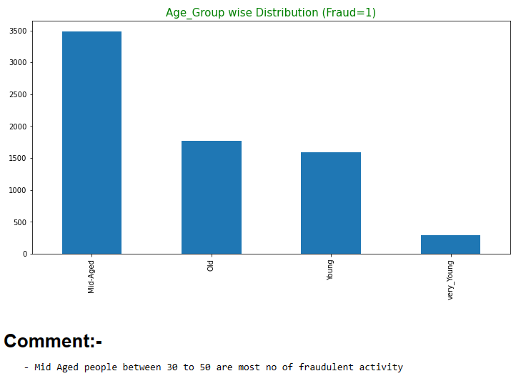
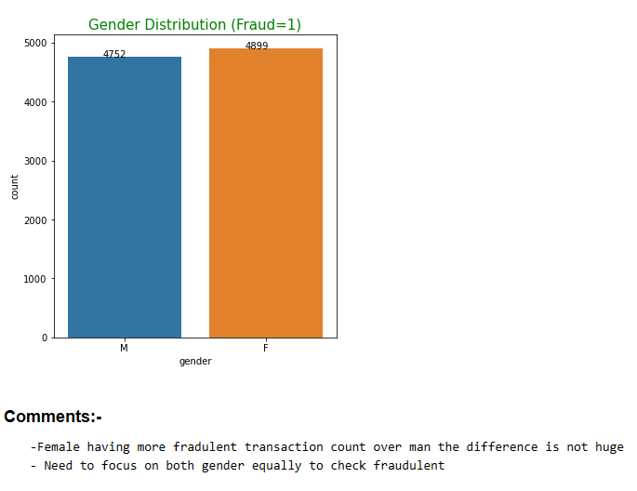

Slide 8
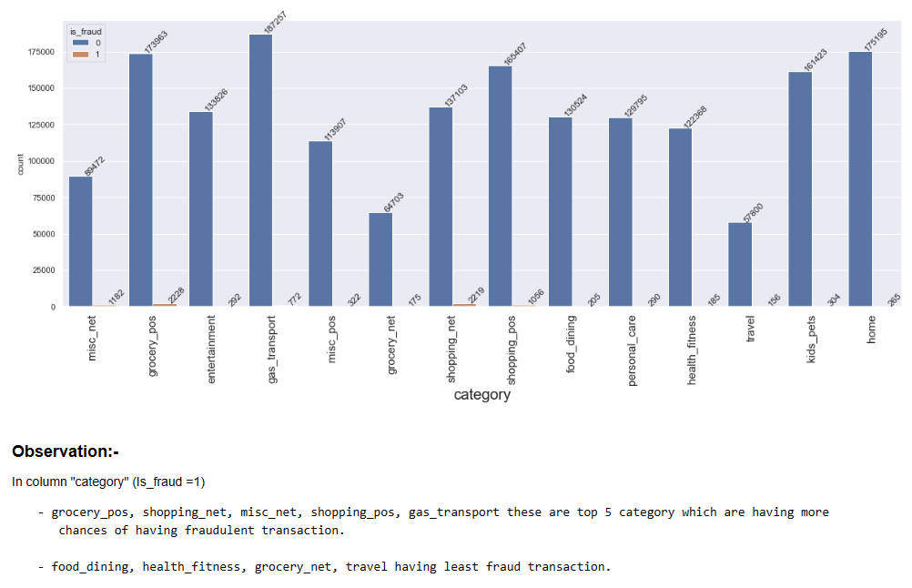
Transaction amount, category and gender are the most important variables

Slide 9
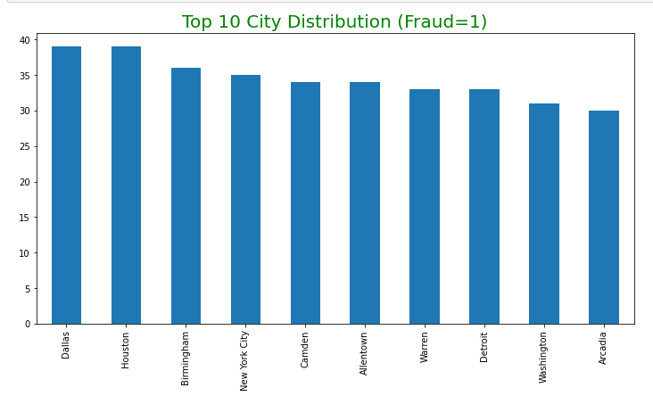
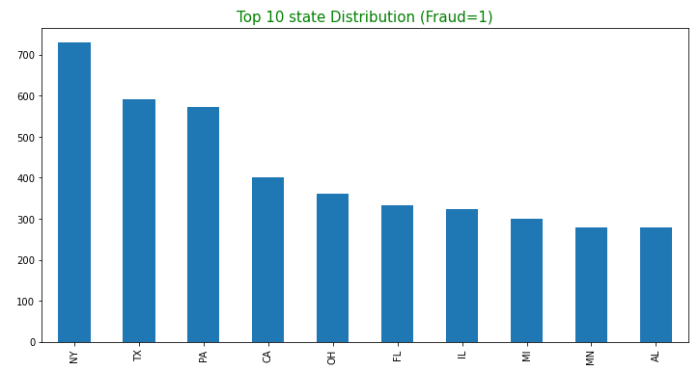

Slide 10
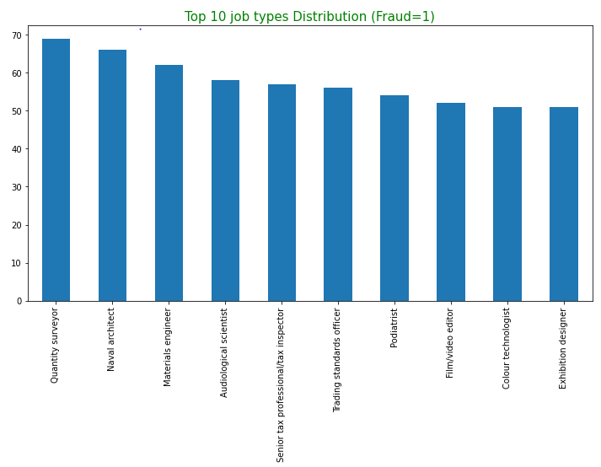
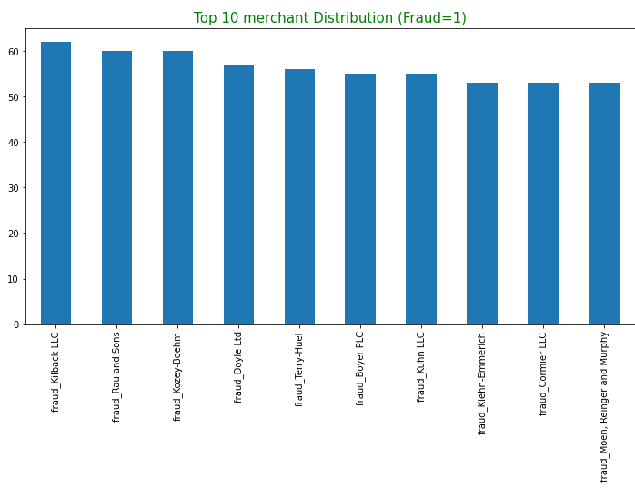

Slide 11
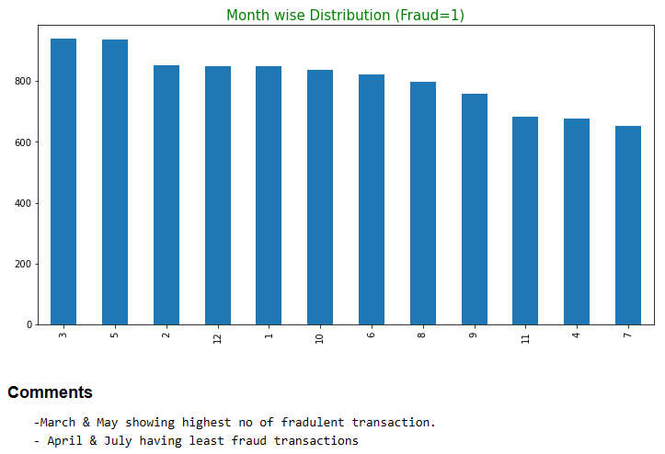
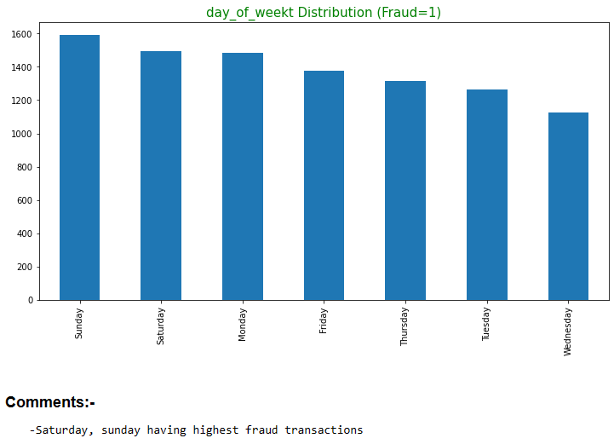

Slide 12
Cost Benefit Analysis
Part 1 – Cost Benefit Analysis
Sr. No. | Questions | Results
1 | Average number of transactions per month | 77,183
2 | Average number of fraudulent transaction per month | 402.12
3 | Average amount per fraud transaction | 530.661

Slide 13
Part 2 – Cost Benefit Analysis
Reduction in losses by ~82%
Sr. No. | Questions | Results
1 | Cost incurred per month before the model was deployed (b*c) | 213392.22
2 | Average number of transactions per month detected as fraudulent by the model (TF) | 237
3 | Cost of providing customer executive support per fraudulent transaction detected by model | 1.5
4 | Total cost of providing customer support per month for fraudulent transactions detected by the model (TF*$1.5) | 355.50
5 | Average number of transactions per month that are fraudulent but not detected by the model (FN) | 68
6 | Cost incurred due to fraudulent transactions left undetected by the model (FN*c) | 35908.09
7 | Cost incurred per month after the model is built and deployed (4+6) | 36263.59
8 | Final savings = Cost incurred before - Cost incurred after(1-7) | 177128.63

Slide 14
Appendix: Data Attributes
Snapshot of the data:
index - Unique Identifier for each row
trans_date_trans_time- Transaction DateTime
cc_num - Credit Card Number of Customer
merchant - Merchant Name
category - Category of Merchant
amt - Amount of Transaction
first - First Name of Credit Card Holder
last - Last Name of Credit Card Holder
gender - Gender of Credit Card Holder
street - Street Address of Credit Card Holder
city - City of Credit Card Holder
state - State of Credit Card Holder
zip - Zip of Credit Card Holder
lat - Latitude Location of Credit Card Holder
long - Longitude Location of Credit Card Holder
city_pop - Credit Card Holder's City Population
job - Job of Credit Card Holder
dob - Date of Birth of Credit Card Holder
trans_num - Transaction Number
unix_time - UNIX Time of transaction
merch_lat - Latitude Location of Merchant
merch_long - Longitude Location of Merchant
is_fraud - Fraud Flag <--- Target Class

Slide 15
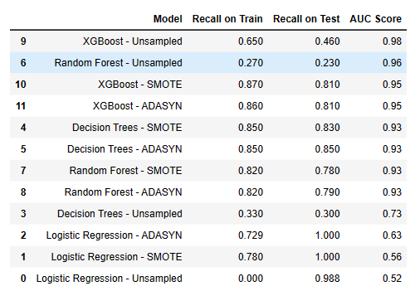
Appendix: Data Methodology
Multiple ML Model classifier built on top of a Kaggle-simulated dataset - screenshot
Class imbalance adjusted using Adaptive Synthetic (ADASYN)/SMOTE sampling method
Manual hyperparameter tuning is done due to extensive computational times when using Grid Search Cross Validation

Slide 16
Appendix: Attached Files
Cost Benefit Analysis:
Cost Benefit Analysis_FRAUD_PS_VS_SJ.xlsx
Multiple ML Model deployments:
credit card fraud_DA_capstone_PS_VS_SJ.ipynb
video submission Link:-

